Slide 1
The Importance of Value & Belief

Slide 2
2 Tickets to the 2014 Master’s Tournament
What Is It Worth To You?

Slide 3
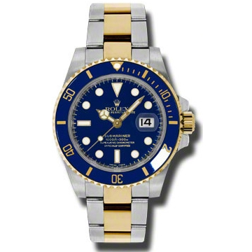
A brand new Rolex Submariner Gold & Steel Watch
What Is It Worth To You?

Slide 4
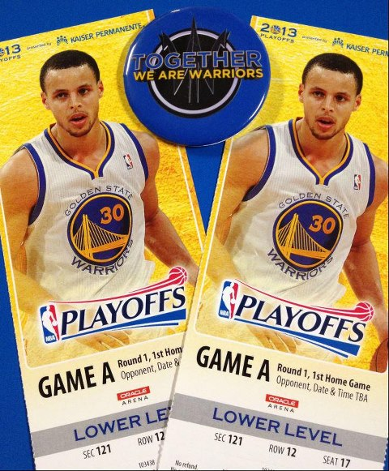
Game 3 – 1 Pair of Warriors Playoff Tickets – Section 121 Row 12
What Is It Worth To You?

Slide 5
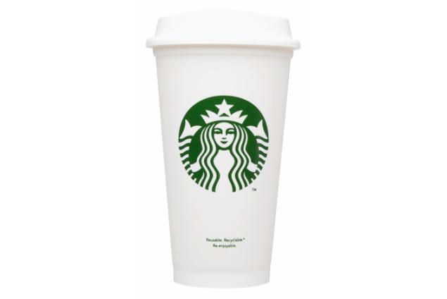
A Venti Cup of Starbucks Coffee
What Is It Worth To You?

Slide 6
What Did It Really Cost?
2014 Masters = $1220.00 per day on GoTickets.com
*** $4880.00 for 4 days worth of tickets
Rolex Watch = $9,500.00 on Overstock.com
Warriors Playoff Tickets = $475.00 per ticket on Stub Hub
Starbucks Venti Coffee = $4.75 at Starbucks downstairs

Slide 7
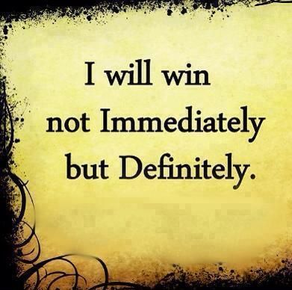
It All Starts With Belief!

Slide 8
What It Takes To Win
Recognize that you decide what it’s worth. If you believe in it, sell it and don’t compromise your worth. The only way you receive less than your value is by accepting it. It begins and ends with your confidence in what you have to work with.
Be able to visualize in your mind what it will look like when you close the big deal. If you can’t see it, you won’t do it.
In order to earn someone’s business we must work harder, smarter & further in advance than those we compete against; Everything we gain is earned thru hard work, risk taking, being smart and creative and having a great product that can deliver results!
Remember (and never forget) that we have two key purposes:
A) To deliver GREAT content that meets the audiences expectations & generates ratings
B) To attract business and generate strong results thru associating with our brand

