Slide 1
10 Seconds Engaging from the start…

Slide 2
10 Seconds
The average listener’s attention span is only 10 seconds
Get them hooked in the first 10 seconds.
Draw them in.
Set up is critical.
EMOTION moves people to action 3,000 times faster than logic.
Find the emotion in the content, NOT the logic!

Slide 3
Content Grading System
A= Highly perishable material on everyone’s mind.
B= Might be topical but relates to or affects listeners’ lives.
C= Something that is interesting, trivia. Not topical or relevant (news of the weird, etc.)
D= Something of interest ONLY to people on the show.
F= Something that 50% of the audience will disagree with or be offended by.

Slide 4
Your Life
“C”
Listener’s Life
“B”
Good
Content
“A”

Slide 5
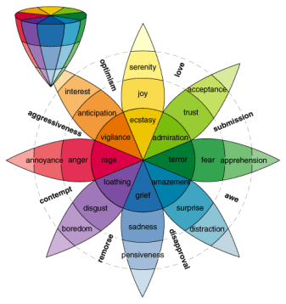
Find the emotion in the content, NOT the logic!

Slide 6
All good stories start with a strong premise, and possess these 3 qualities:
Strong setup & defined position
The facts, and only the facts
Memorable conclusion

Slide 7
Language is music…and you must be Paul McCartney

